Slide 1
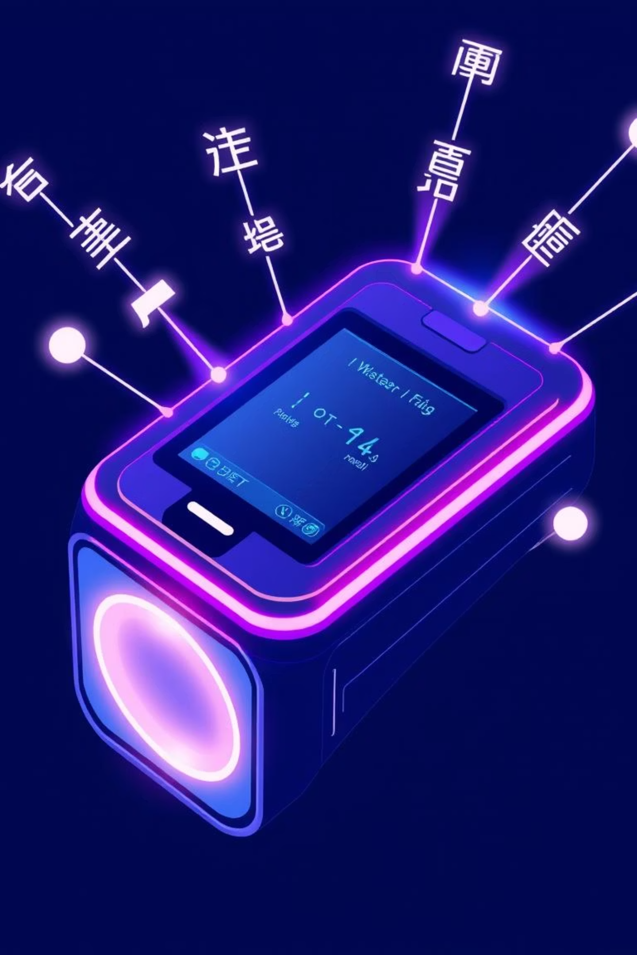
EchoTranslator: AI-Powered Multi-Language Translator
Presented by Mohd Taha Salim

Slide 2
Bridging Divides: The Power of Seamless Communication
In our interconnected world, language barriers can impede progress and understanding. The EchoTranslator project addresses this critical challenge by leveraging cutting-edge Artificial Intelligence to facilitate real-time, accurate, and accessible multi-language translation. This presentation will explore the project's purpose, functionality, and the innovative technologies that make it possible.

Slide 3
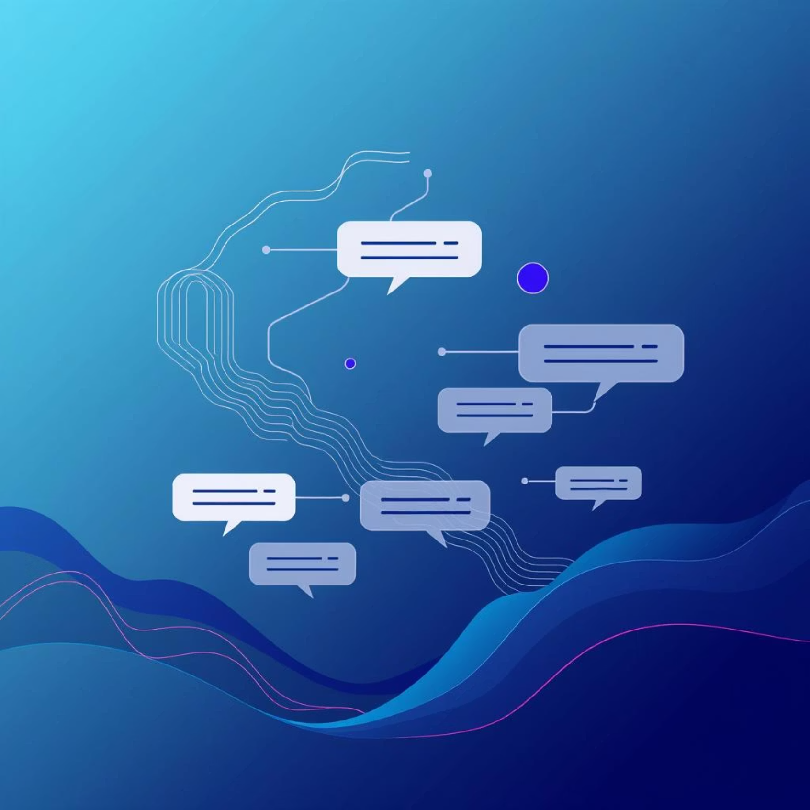
EchoTranslator: A Seamless Communication Solution
Intuitive Design, Powerful Results
EchoTranslator functions as a comprehensive translation hub. Users can seamlessly input text or speak directly into the application. Our AI engine then processes the input, performing rapid translation, and delivers the output in both text and synthesized speech, emphasizing user-friendliness and remarkable speed.

Slide 4

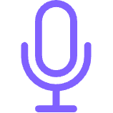


Key Features: Empowering Global Dialogue
Multi-Language Support
Speech-to-Text & Text-to-Speech
Translate between a wide array of languages, fostering broader communication.
Effortlessly convert spoken words to text and vice-versa for comprehensive interaction.
User-Friendly Interface
Real-time Performance
Built with Streamlit for an intuitive and accessible user experience.
Experience near-instantaneous translation for dynamic conversations and interactions.

Slide 5
Under the Hood: Core Technologies
Python
The foundational programming language orchestrating the entire application.
Streamlit
Powers the interactive and responsive user interface, making the application accessible.
Deep Translator
A robust API facilitating accurate and efficient multi-language translation services.
SpeechRecognition
Enables precise capture and conversion of spoken language into text.
gTTS (Google Text-to-Speech)
Transforms translated text back into natural-sounding speech for an immersive experience.

Slide 6
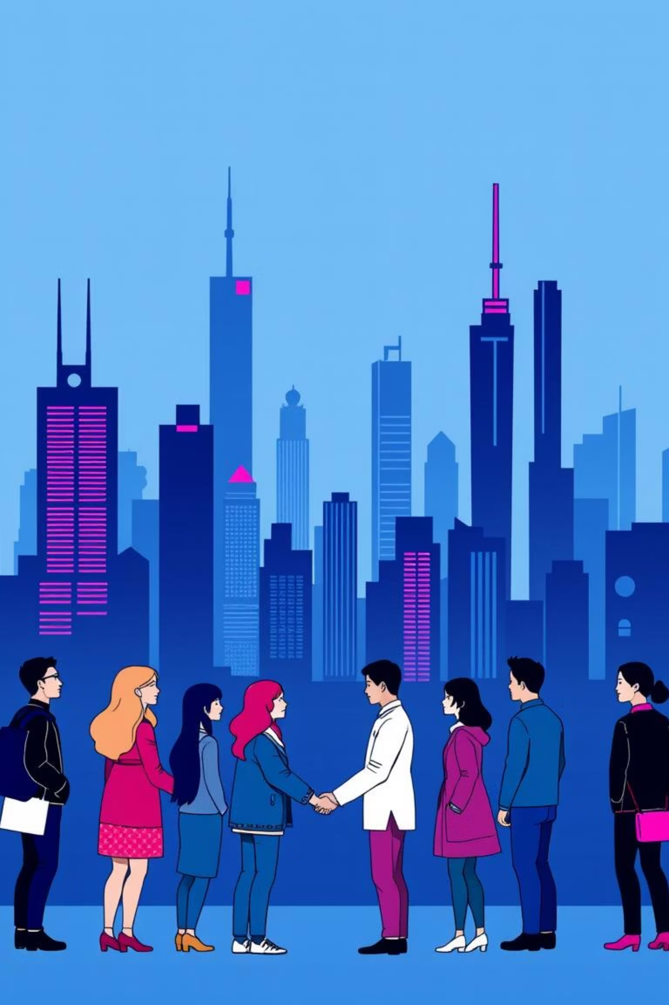
EchoTranslator: A Vision for Global Connection
The EchoTranslator project successfully demonstrates how AI can break down language barriers, fostering a more connected and understanding world. Its intuitive design and powerful features offer significant potential for real-world applications, from enhancing international business communication to facilitating cross-cultural education.
Thank you for your attention.

